Slide 1
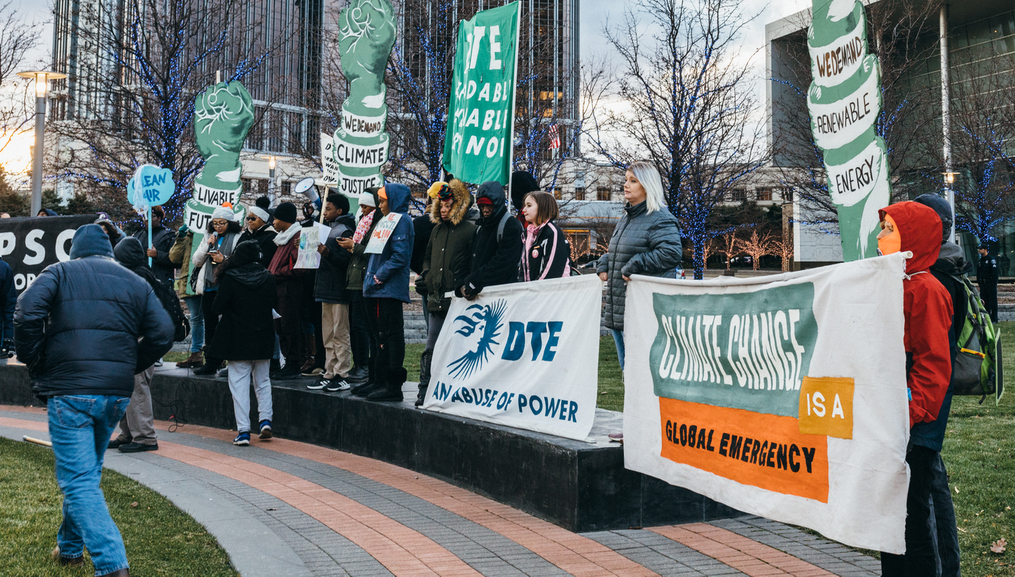
Advancing Environmental Justice in Local Government: A Path Towards Justice and Effective Policymaking Presentation by: Graham Diedrich
Image: Sara Faraj / Michigan Environmental Justice Coalition
Notes:
Good morning, everyone. My name is Graham Diedrich, I’m a graduate student at Michigan State University and a research fellow at the University of Michigan. Today, I am excited to be discussing the role of local governments in advancing environmental justice and effective policymaking.

Slide 2
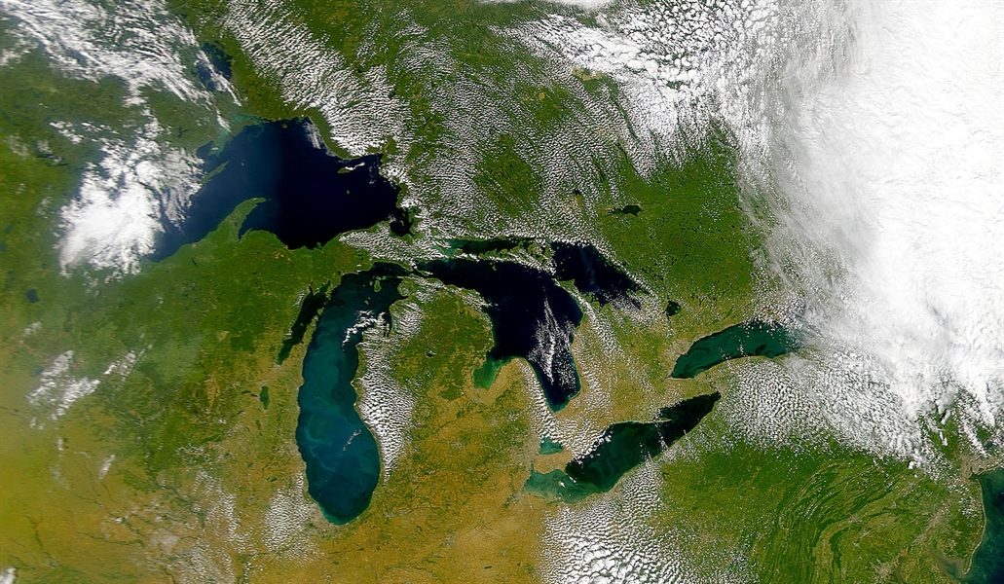
Legislative Role in Advancing Environmental Justice: Local, State, and Federal Action Presentation by: Graham Diedrich
Image: NOAA Research News
Land Acknowledgement
I would like to acknowledge that we are gathering on the traditional, ancestral, and current homelands of the Three Fires Confederacy, the Ojibwa, Odawa, Potawatomi, and Wyandot nations.
Notes:
Before we begin, I would like to start by acknowledging that we are gathering on the traditional, ancestral, and current homelands of the Three Fires Confederacy, the Ojibwa, Odawa, Potawatomi, and Wyandot nations.

Slide 3
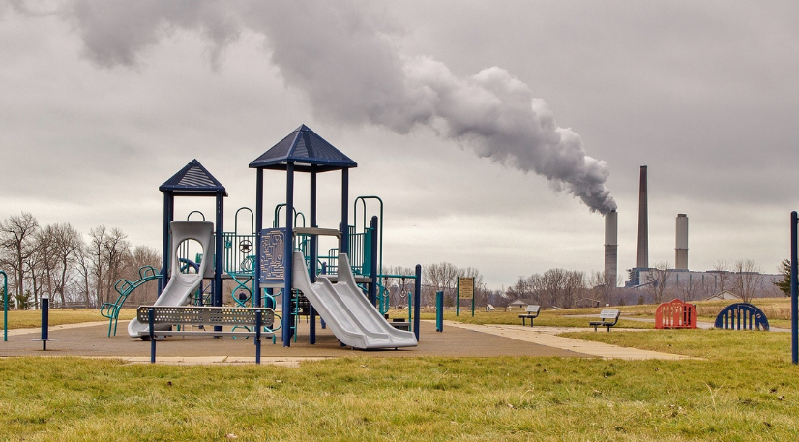
Image: National Caucus of Environmental Legislators
Environmental injustices impact countless communities.
Notes:
Let’s start by centering the environmental injustices that impact countless communities across this state, the county, and our world.

Slide 4
Notes:
Across the United States, Black, indigenous, and people of color are dipropionate exposed to all types of environmental burden, to pollution, heat intensity, and climate change. The implications of which are staggering, and lead to negative health, educational, employment, and life outcomes.
And what your seeing on the screen are recent headlines. There are countless intendents which go unreported.

Slide 5
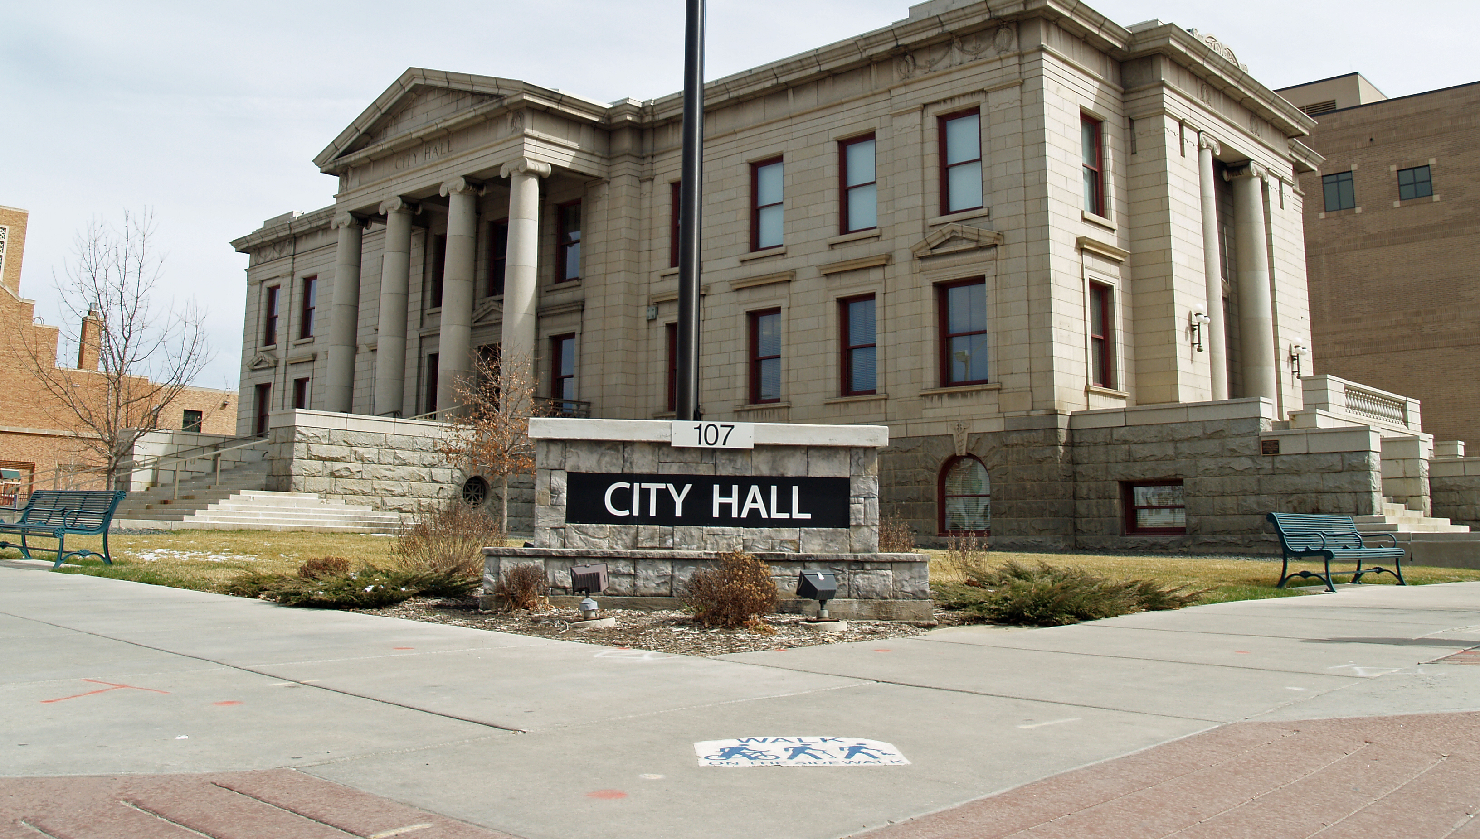
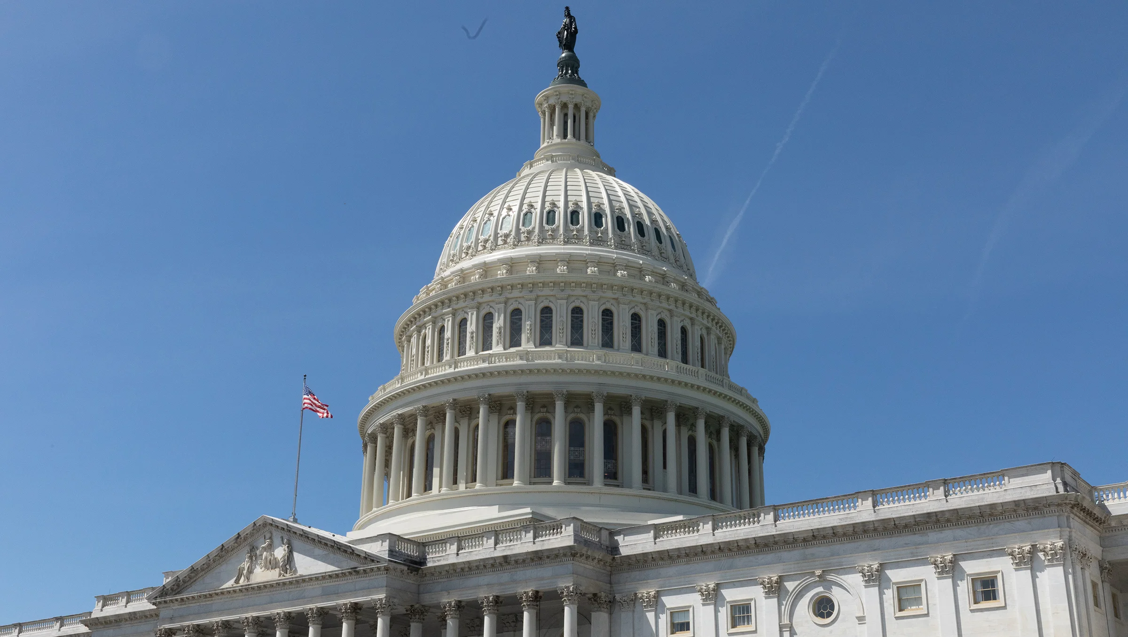
Image: David Shankbone
Image: Sara Faraj / Michigan Environmental Justice Coalition
What role can local governments play in uprooting these injustices?
Notes:
So then, the questions becomes this: what role can local governments play in uprooting these injustices? Throughout this presentation, I hope to provide a framework for local and state actors to better interrogate this question in their own communities.
Now, the premise that there is even a role of local governments in combatting environmental injustices is a relatively new one, especially considering the fact that these are some of the very institutions that have led to disproportionate, racialized burdens.

Slide 6
Image: Sara Faraj / Michigan Environmental Justice Coalition
Environmental Federalism
Each level of government carries different sets of responsibilities related to environmental policy and regulation
Division of responsibilities in both directions, between federal, state, and local government
Federal
State
State
Local
Notes:
But bear with me as I explain how environmental policy in this county operates among some key actors: federal, state, and local governments. We refer to this system as environmental federalism, where each level of government carries a different set of roles and responsibilities.
For instance, the federal government may establish primary standards for regulated pollutants and dispense monies to state agencies to support regulatory enforcement and program rollout. The states then determine how to utilize these funds, typically with a minimum set of guidelines from the federal government. In most cases, states then devolve land-use decisions and other pieces of program implementation to local governments.
So, we can see that the division of responsibilities flows in both directions, in a top-down, and bottom-up fashion.

Slide 7
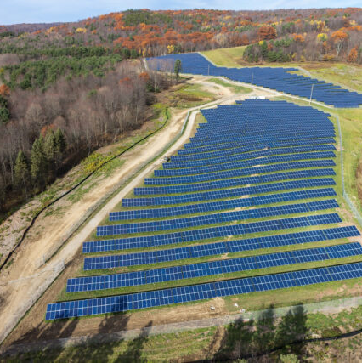
Local governments can significantly impact EJ outcomes.
Land-use planning and zoning
Transportation infrastructure
Water and utility systems
Solid waste and material reuse
Energy efficiency and weatherization
Image: Silicon Ranch Corp.
Notes:
This is important to recognize, as local governments have key tools at their disposal which can significantly impact environmental justice outcomes. For instance, they generally have land-use and zoning powers, allowing them to determine how land is allocated and what types of activities are permitted in different areas. Local governments can use their land-use and zoning powers to implement policies that prevent the siting of polluting industries near low-income neighborhoods or communities of color. They can establish buffer zones between industrial facilities and residential areas to reduce exposure to harmful emissions. Additionally, they can incentivize the development of green spaces, parks, and other recreational areas in underserved communities.
They will often have control over transit, either in a local or regional capacity, where they can focus on accessible access. Water and utility systems managed by municipalities should seek to address water disparities in access and affordability.
Additionally, local governments can implement waste reduction and recycling programs to minimize the amount of waste sent to landfills or incinerators. Finally, municipal utilities can pursue and incentivize energy efficiency and weatherization in older housing stock, which is disproportionality owned by people of color.

Slide 8
Cities across the U.S. are being to acknowledge their pivotal role.
69%
Source: Diezmartínez & Gianotti, 2022
Notes:
Cities across the U.S. are already acknowledging their pivotal role. As of 2020, 69% of the largest cities in the country with a climate action plan have incorporated justice and equity concerns. This number has risen sharply since the early 2000s.

Slide 9
Local climate plans in Michigan are incorporating EJ concerns.
Notes:
Even in Michigan, local climate plans are beginning to incorporate themes of environmental justice. Several municipalities are highly aware of the connection between justice and climate action, and have even taken steps to analyze and introduce policies to distribute benefits and costs in an equitable manner.

Slide 10
Image: David Shankbone
Image: Sara Faraj / Michigan Environmental Justice Coalition
How can municipalities begin to make an impact?
Notes:
Given all of this, I want to introduce some tangible ways municipalities can begin to make an impact, this the qualification that all communities are unique which makes a “one-size-fits-all” approach difficult.

Slide 11
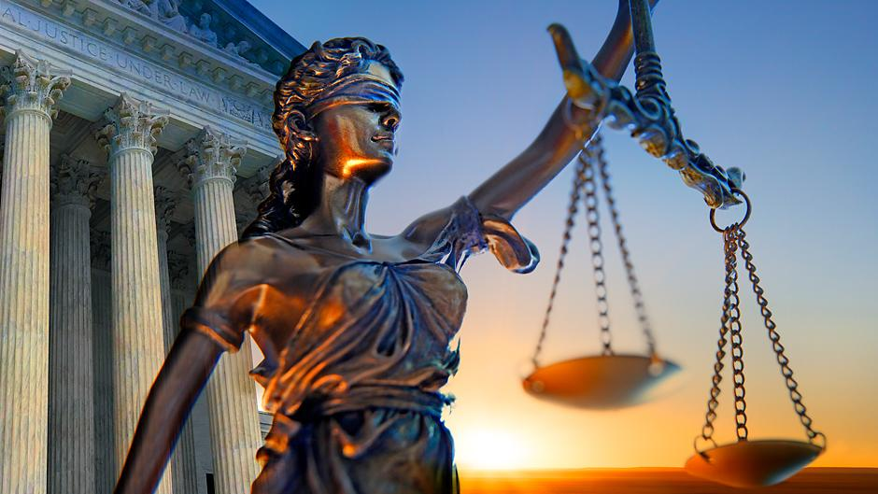
Recognition
Co-Creation
A Path Towards Justice Led By Local Communities
Outreach and Engagement
Integration
Information Gathering
Institutionalization
Notes:
The path towards justice begins with recognition of environmental injustices: who are they impacting, where are they manifesting, and what systems encourage them. After this, outreach and engagement is crucial for understand community needs, as is information gathering to inform policy development and funding opportunities.
Co-creation of policy should occur between EJ communities and other stakeholders. Once a policy has been created, it must be integrated and institutionalized into all facets of a local governments operations, to avoid it being sidelined to one unit or department.
Let’s go into some further detail into these steps.

Slide 12
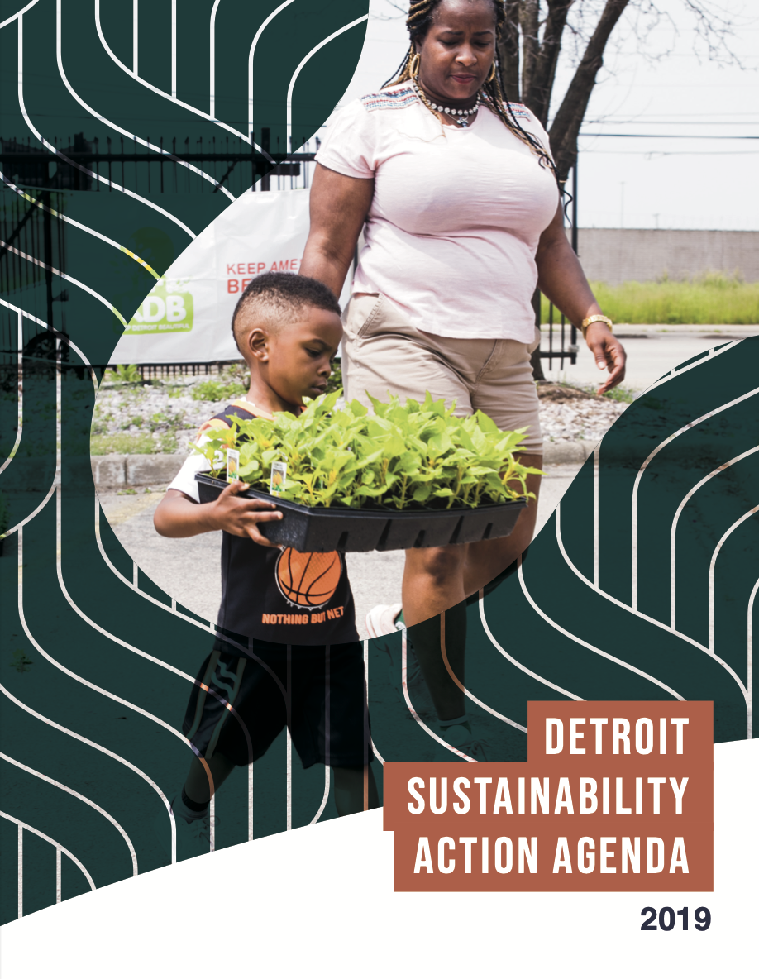
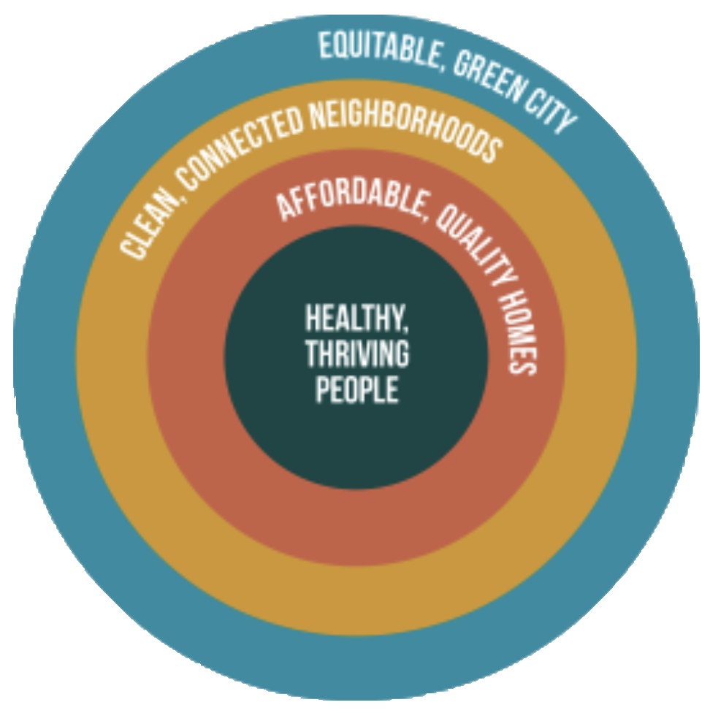
Image: Sara Faraj / Michigan Environmental Justice Coalition
Recognition
Policies should explicitly recognize the importance of addressing specific and localized environmental inequalities
A strategic plan or report could provide the basis for acknowledgement
Image: City of Detroit
Notes:
Actions begins with the acknowledgement that problems exist and demand to be solved. As a result, policies should explicitly recognize the importance of addressing environmental inequalities. Strategic plans, like a climate action plan, should be sufficiently localized: noting how environmental issues impact communities in a local context. Here is an example of the Detroit Sustainability Action Agenda, which presents equity, health, and affordability as key pillars of the recommendations that is makes.
EXAMPLE: expanding access to green jobs and training

Slide 13
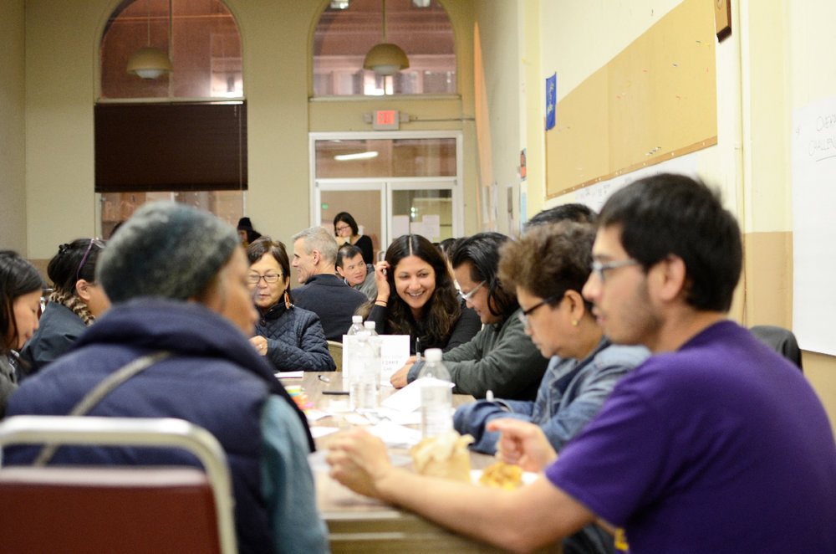
Image: Sara Faraj / Michigan Environmental Justice Coalition
Outreach and Engagement
Proposals should be guided by environmental justice communities of concern
Both a matter of principle and effective, sustainable policymaking
Relies upon reaching out and listening to the needs of community members
Image: Unsplash
Notes:
Once issues are identified, culturally responsive outreach must occur. Policy proposals should be guided by EJ communities themselves, which is both a matter of principle and effective, sustainable policymaking. Without community by in, policy proposals may lack legitimacy and fail to address the specific needs and concerns of EJ communities. As a result, this engagement process relies upon listening to community members to develop a policy framework.

Slide 14
Image: Sara Faraj / Michigan Environmental Justice Coalition
Information Gathering
Policy Development
Funding
Surveys and community engagement
Emissions inventory
Tree canopy and green space analysis
Housing review
Federal grants
State programs
Non-profit organizations
Local financing tools
Notes:
Information gathering can occur in before, after, or in tandem with outreach and engagement. Information gathering can be thought of as two activities: collecting data on policy development and funding arrangements. Surveys, emissions inventories, tree canopy and green space analyses, and housing reviews can all inform what injustices are manifesting in a local community. Information regarding funds can be collected from federal, state, and non-profit agencies, as well as considering innovate local financing tools, like the climate millage recently passed in Ann Arbor.

Slide 15
Image: Sara Faraj / Michigan Environmental Justice Coalition
Co-Creation
Working with environmental justice communities and other stakeholders to develop policies
Significant for integration and institutionalization stages
Image: Unsplash
Notes:
With this information, policies should be created in a collaborative environment. Community members, advocacy organizations, non-profit leaders, and others should be involved in the co-creation of policy. Shared decision-making and transparent communication between actors is crucial for this stage, as what is established here becomes significant for what comes next.

Slide 16
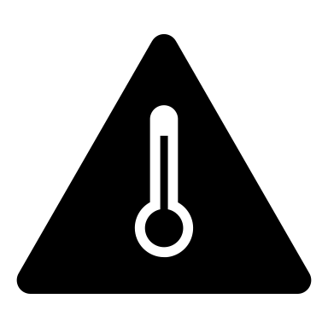
Image: Sara Faraj / Michigan Environmental Justice Coalition
Integration
Integration centers on participation, separation of responsibilities, and an acknowledgement of priorities between government departments
Without integration, a holistic approach is difficult to achieve
City of Greenvillage
Health and Human Services
Public Works
Planning
Notes:
Integration centers on participation, separation of responsibilities, and an acknowledgement of priorities between government departments.
Let’s consider the fictious City of Greenvillage. The City has three departments: pubic works, planning, and health. All three have different priorities as they relate to climate change.
Health and Human Services is concerned with rising temperatures, and would like to explore strategies to mitigate the health impacts of extreme heat events, such as heat warning systems. Planning wants to insure that Greenvillage has adequate infrastructure to accommodate the rise in EVs across the state, and would like to develop a charging network with the support of private and public support. Finally, Public Works sees the threats poised by flooding events, and wants to upgrade storm systems to handle a greater degree of risks.
If these ideas are not considered in a holistic fashion, the potential for missed opportunities, inefficiencies, and conflicts may arise. Without integrated approach the priorities and strategies of the different departments are lost, meaning that the City is less able to combat climate change and environment injustices.

Slide 17
Image: Sara Faraj / Michigan Environmental Justice Coalition
Institutionalization
Uplifts environmental justice and climate action as key policy goals for all units of local government
Ensures that there are formal structures in place to cope with relevant policy problems
Environmental Justice
Local Government Responsibilities
Notes:
Once a shared and integrated policy approach has been developed, this vision must be institutionalized in every facet of government operations. Environmental justice and climate action should be upheld as core to the goal of government, similar to public safety and economic development. As a result of institutionalization, there is a formal structure in place for a variety of internal and external actors to cope with policy issues together.

Slide 18
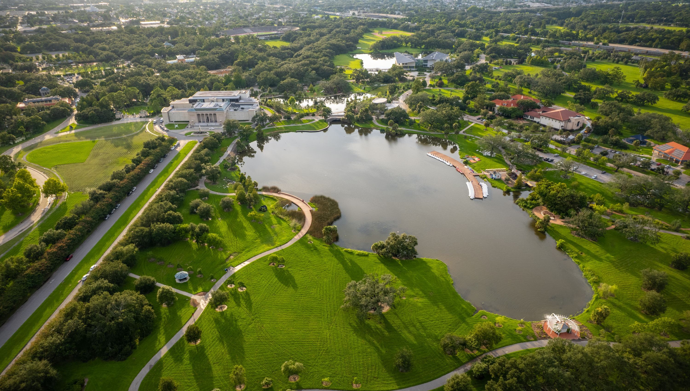
Image: Sara Faraj / Michigan Environmental Justice Coalition
Image: Unsplash
Key Takeaways
Notes:
Now, let’s quickly go through some takeways.

Slide 19
Image: Sara Faraj / Michigan Environmental Justice Coalition
1
There is a key role for all levels of government in mitigating environmental harms.
Notes:
One: there is a key role for all levels of government in mitigating environmental harms. The prioritization of local action is not to stay federal and state actors are off the hook. Everyone must contribute to a comprehensive, collaborative policy environment.

Slide 20
Image: Sara Faraj / Michigan Environmental Justice Coalition
2
Local governments can utilize their powers to improve infrastructure, engage with communities, and create equitable outcomes.
Notes:
Two: local governments can utilize their powers to improve infrastructure, energy systems, zoning, and engage in communities.

Slide 21
Image: Sara Faraj / Michigan Environmental Justice Coalition
3
Federal and state funding for these initiatives is crucial for effective, localized policymaking.
Notes:
Three: Federal and state dollars are crucial in supporting the role of local actions, which is why state and federal initiatives should recognize that there is no “one-size-fits-all” approach to combatting environmental injustices. Instead, they should lean into the powers and abilities of local governments by supporting their work.

Slide 22
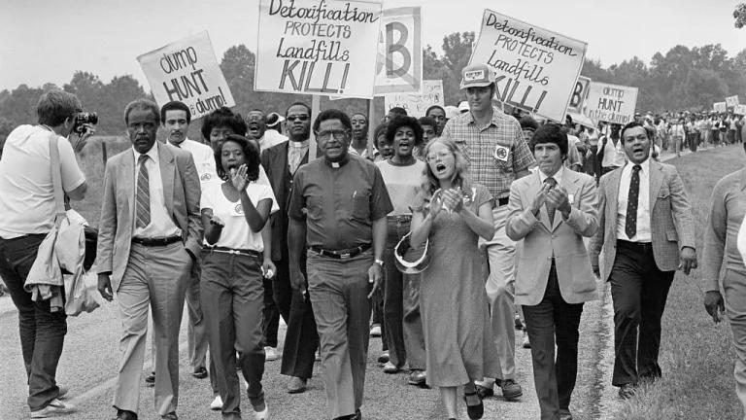
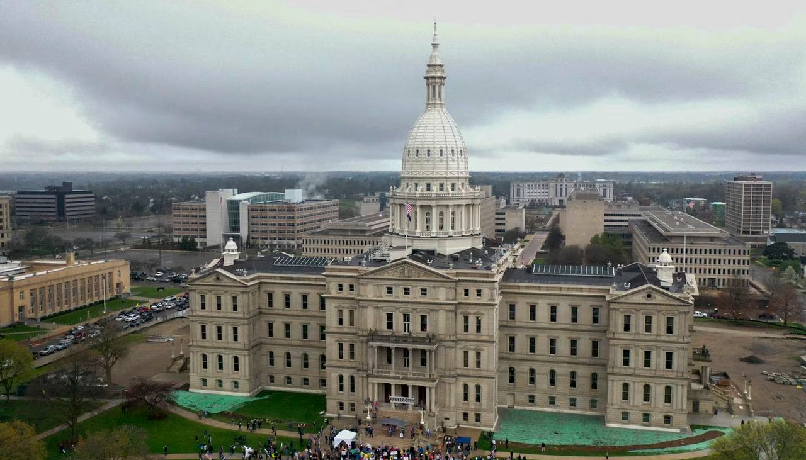
Image: Unsplash
Image: Sara Faraj / Michigan Environmental Justice Coalition
In every community, there is a path towards justice.
Notes:
Leaving on a positive note, I would like to emphasize that in every community, there is a path towards justice.

Slide 23
Image: Sara Faraj / Michigan Environmental Justice Coalition
Thank you!
Notes:
Thank you!

Slide 24
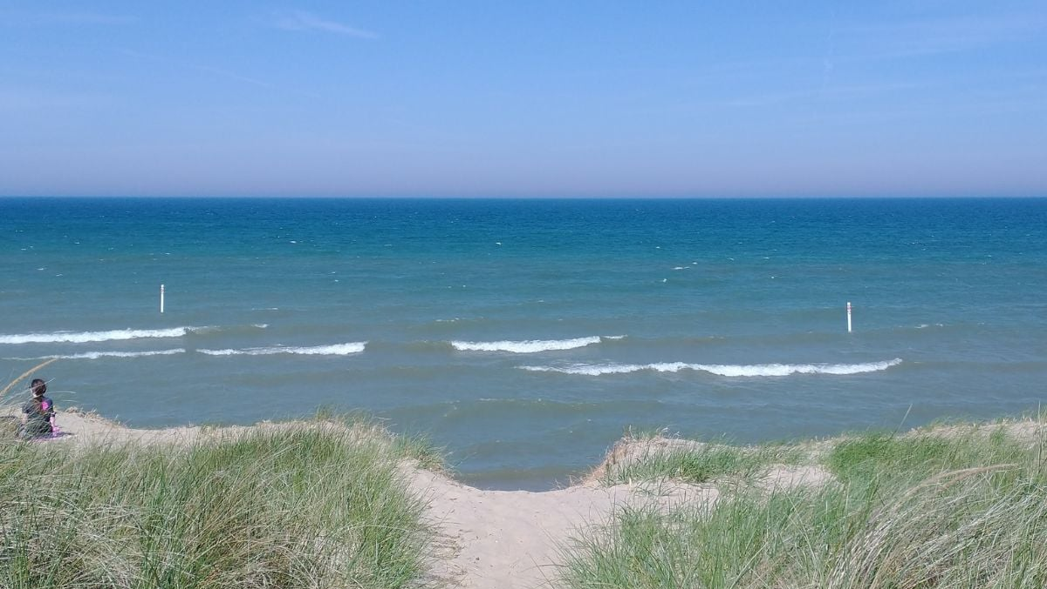
Legislative Role in Advancing Environmental Justice: Local, State, and Federal Action Presentation by: Graham Diedrich
Image: Unsplash
Michigan State University Forest Carbon & Climate Program
University of Michigan Graham Sustainability Institute
Graham Diedrich, MPP
diedgr@msu.edu
Notes:
Please feel free to contact me any time, it was a pleasure being able to speak to you all today.

Slide 25
Image: Sara Faraj / Michigan Environmental Justice Coalition
References
CNN. (2023). A quarter of Americans live with polluted air, with people of color and those in Western states disproportionately affected, report says. Retrieved from https://www.cnn.com/2023/04/19/health/state-of-the-air-2023/index.html
Diezmartínez, C. V., & Short Gianotti, A. G. (2022). US cities increasingly integrate justice into climate planning and create policy tools for climate justice. Nature Communications, 13(1), 5763. https://doi.org/10.1038/s41467-022-33392-
Mother Jones. (2023). Wildfire smoke is making Black communities sicker. Retrieved from https://www.motherjones.com/environment/2023/06/wildfire-smoke-black-communities-asthma-pollution-risk/
Harvard T.H. Chan School of Public Health. (2023). Communities of color disproportionately exposed to PFAS pollution in drinking water. Retrieved from https://www.hsph.harvard.edu/news/press-releases/communities-of-color-disproportionately-exposed-to-pfas-pollution-in-drinking-water/
Los Angeles Times. (2023). White drivers are polluting the air breathed by L.A.'s people of color. Retrieved from https://www.latimes.com/environment/newsletter/2023-03-09/white-drivers-are-polluting-the-air-breathed-by-l-a-s-people-of-color-boiling-point
Earthjustice. (2023). As carbon capture facilities boom, overburdened communities may deal with the waste they create. Retrieved from https://earthjustice.org/brief/2023/as-carbon-capture-facilities-boom-overburdened-communities-may-deal-with-the-waste-they-create

Slide 26
Image: Sara Faraj / Michigan Environmental Justice Coalition
Images
Sara Faraj / Michigan Environmental Justice Coalition: https://secure.everyaction.com/JqRTTnh5y0m6xsAGtGrjDA2
National Caucus of Environmental Legislators: https://www.ncelenviro.org/resources/environmental-justice-one-pager/
David Shankbone: https://commons.wikimedia.org/wiki/File:Colorado_Springs_City_Hall_by_David_Shankbone.jpg#mw-jump-to-license
Silicon Ranch Corp.: https://www.tennessean.com/story/money/2018/01/15/phil-bredesen-silicon-ranch-solar-shell-investment-up-217-m/1033391001/
City of Detroit: https://detroitmi.gov/departments/general-services-department/office-sustainability/detroit-climate-strategy
Unsplash: https://unsplash.com

